Slide 1
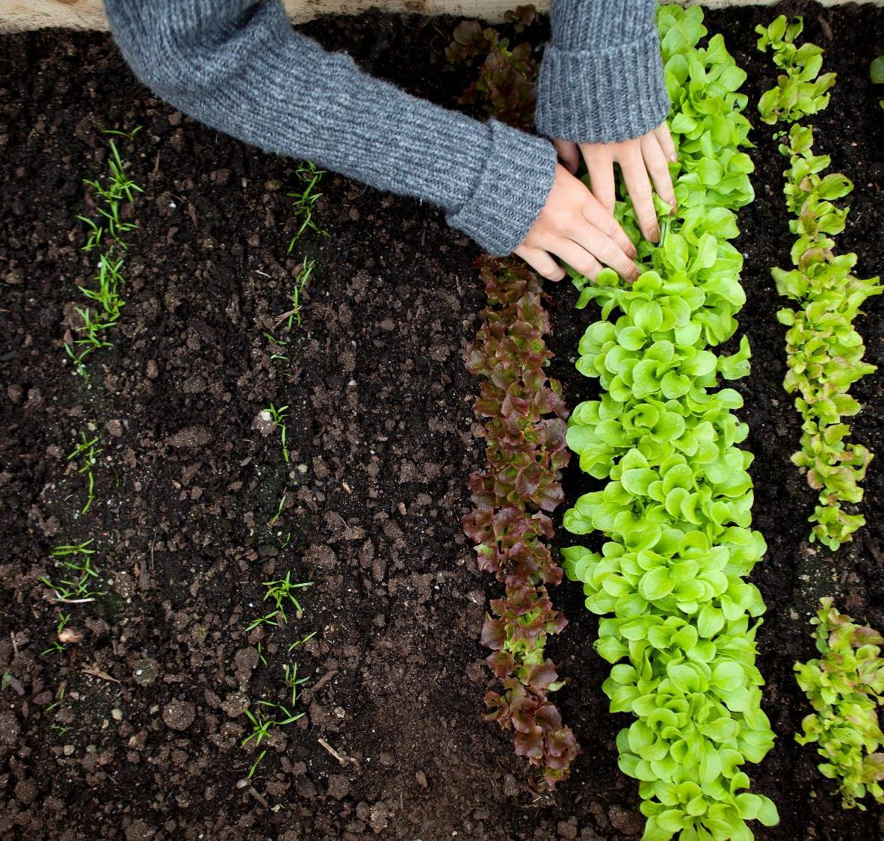
AGRO VISION A Machine Learning-Based Crop and Fertilizer Recommendation System.

Slide 2

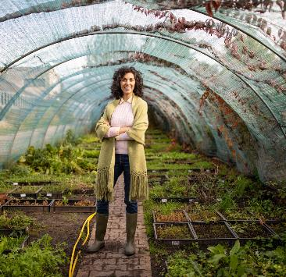
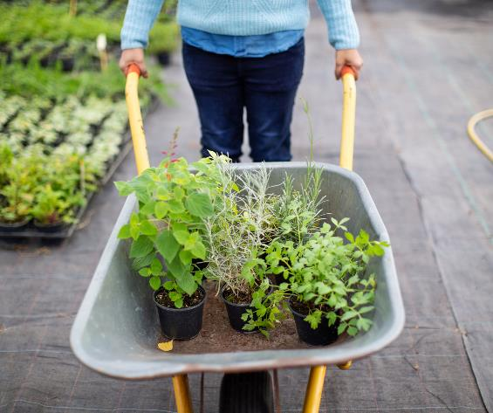
MOTIVATION
Indian agriculture is being plagued by various problems. The biggest problem with Indian farmers is the crop selection. The relevance of the ongoing project is that the crop prediction and selection of the right crop will help the farmer to increase their earnings .
New technologies, such as Machine Learning is being implemented into agriculture so that it is easier for farmers to grow and maximize their yield.

Slide 3
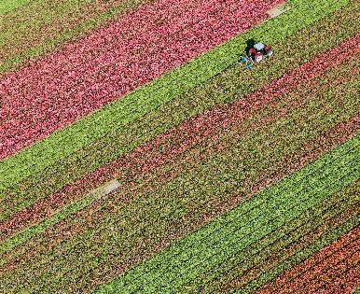
ABSTRACT
AgroVision is a machine learning-based system that recommends the best crop to grow and fertilizers to use based on environmental factors, with the aim of helping farmers optimize their crop yields and reduce waste.
By analyzing soil data, weather patterns, and other environmental factors, our system generates personalized crop and fertilizer recommendations for farmers, providing insights on optimal crop varieties.
The project is designed to be user-friendly and accessible, providing farmers with easy access to personalized recommendations that can help them make informed decisions about crop selection and resource management.

Slide 4
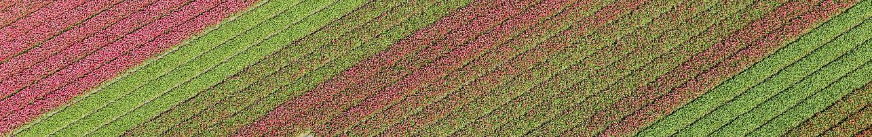
LITERATURE SURVEY
S.No | Date | Title | Description
1. | 22 oct,2020 | Crop Recommendation System -Pradeepa Bandara Lecturer, Sri Lanka Institute of Information Technology Sri Lanka ,et al | To train the crop recommending model with the data collected. Machine learning algorithms are used to identify the best crop to cultivate with the highest probability of growing. Naïve Bayes & Support vector machine algorithms are used to select the best crop type.

Slide 5
LITERATURE SURVEY
S.No | Date | Title | Description
2. | 3 August,2020 | Crop yield prediction based on Indian agriculture using machine learning. - Nishant2020 International Conference for Emerging Technology (INCET) et al. | This paper have also taken an interesting approach for the prediction by not using the conventional parameters like soil, rainfall, sunlight. However, they have used simpler parameters such as district, crop and seasons which makes it easy for the farmers to understand.

Slide 6
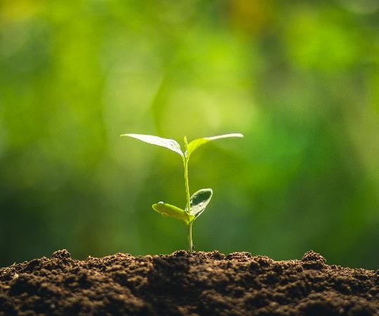

Functional Requirements
Data Collection:
This feature involves collecting data from various sources, such as weather stations, soil sensors and crop history records. (data.gov.in)
Data Analysis:
Once the data has been collected, the system will use machine learning algorithms to analyze the data and identify patterns and correlations.
Crop and Fertilizer Recommendations:
Based on the data analysis, the system will generate personalized recommendations for farmers about which crops to plant and what fertilizers to use.
User-friendly Interface:
The system will have a user-friendly interface that is easy to navigate and understand.

Slide 7
Non-Functional Requirements
Reliability:
The system will be able to recover from any unexpected errors or interruptions and resume normal operation quickly.
Scalability:
The system is designed to be easily scalable by adding additional resources.
Performance:
The system is designed to handle large amounts of data and complex calculations without slowing down or producing errors.
Usability:
The interface is intuitive and easy to use, with clear and concise instructions.

Slide 8
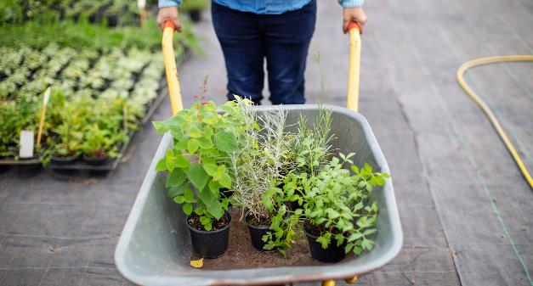
Development Tools
Software Requirements
Hardware Requirements
Operating System: Windows 8 and above.
Jupyter Notebook
Python libraries: sklearn, pandas
Python framework: Flask
PyCharm
Intel core i3 or more
Hard disk: 256GB
RAM: 4GB

Slide 9
MODULAR STRUCTURE
Data Acquisition Module: Responsible for gathering relevant data required for crop recommendation from data.gov.in .
Data Processing Module: Handles the preprocessing and normalization of the acquired data.Cleans and organizes the data for efficient analysis.
Recommendation Engine Module: Utilizes the processed data to generate crop and fertilizer recommendations based on specific criteria and user inputs.
User Interface Module: Provides a user-friendly interface for users to interact with the system.Allows users to input their location, preferences, and constraints.Displays the recommended crops and suggests fertilizers.

Slide 10
EXISTING SYSTEM
In the existing crop recommendation model, they trained the model with the data collected. Machine learning algorithms are used to identify the best crop to cultivate with the highest probability of growing.
LIMITATIONS:
The model was confined to only a particular state (Maharashtra).
It only predicted the crop type based on district , crop and seasons.
This project can only predict crops.

Slide 11
PROPOSED SYSTEM
AgroVision is a machine learning-based system that recommends the best crop to grow and fertilizers to use based on environmental factors.
Our proposed system uses Naïve Bayes algorithm to predict crop and fertilizer based on the multiple inputs from user such as pH level, Nitrogen, Phosphorous, Potassium , rainfall , seasons, state , temperature and humidity.
We are able to get higher accuracy by employing the Navie Bayes method.
The project is designed to be user-friendly and accessible, providing farmers with easy access to personalized recommendations that can help them make informed decisions about crop selection and resource management.

Slide 12
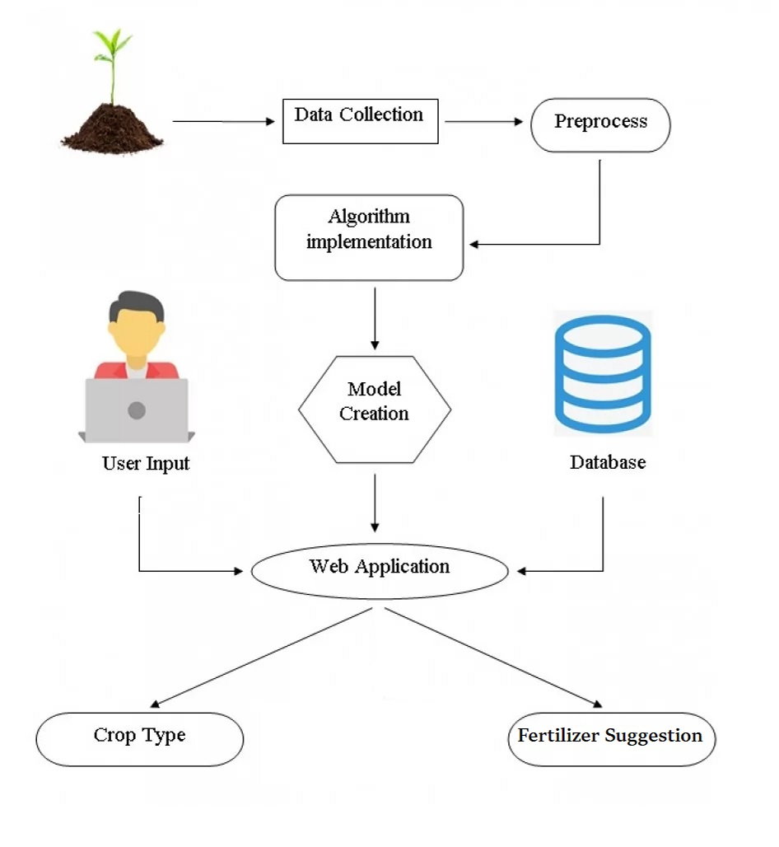
SYSTEM ARCHITECTURE

Slide 13
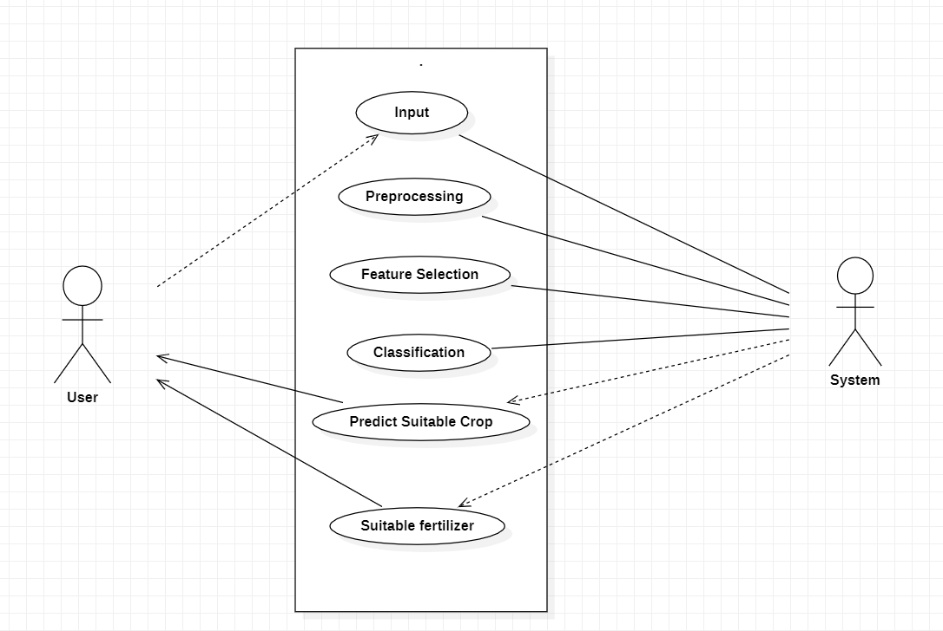
USE CASE DIAGRAM

Slide 14


FUTURE SCOPE
Crop Disease prediction.
Localizing our website by making it available in native languages.
Creating a mobile application from our website.

